Slide 1
MOIN
SEMINAR
THREE JS
July 2021 by Jongjin Na
Notes:
Note: Please after inserting your picture, “Right Click” on the picture and “Send it to Back” to get the “Gradient” effect.
1.5

Slide 2
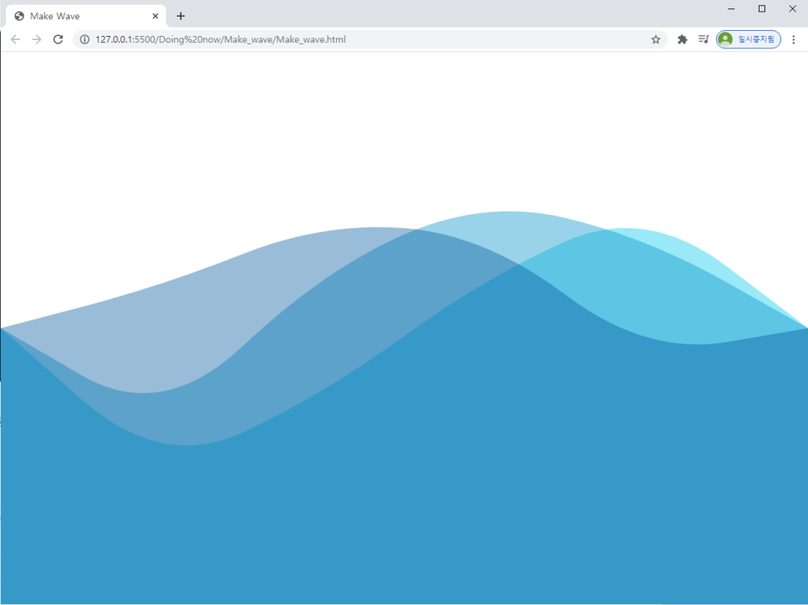
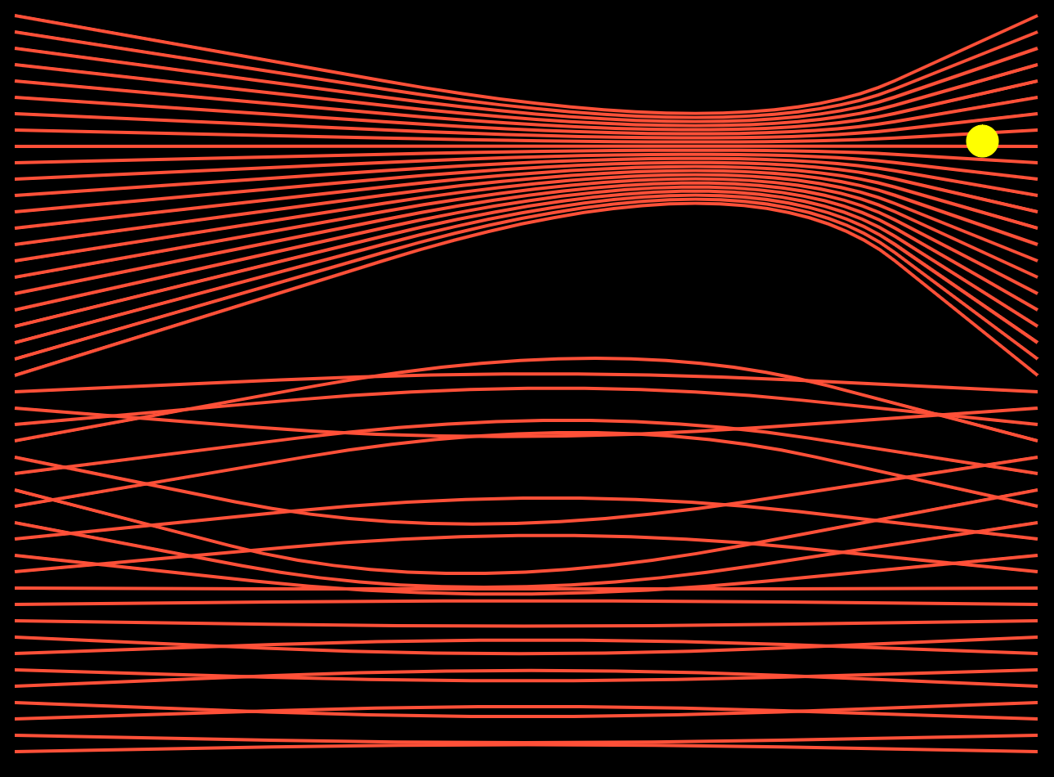
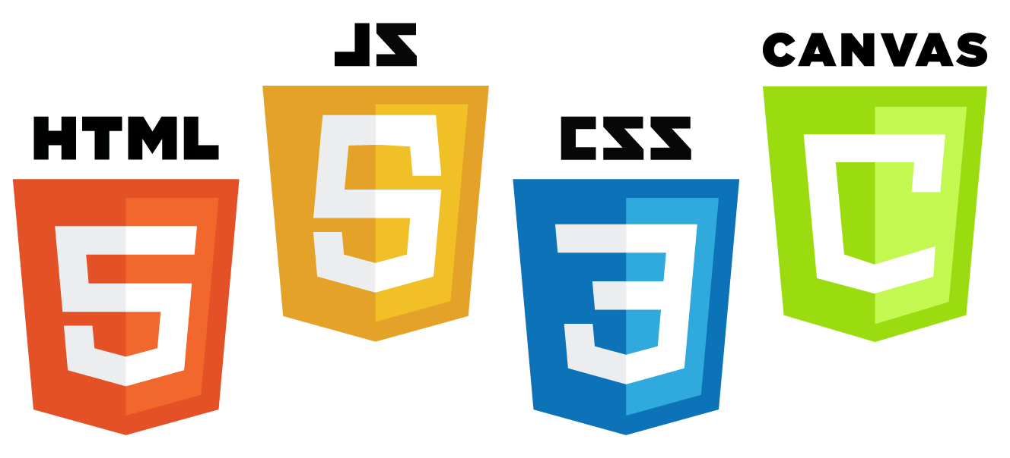
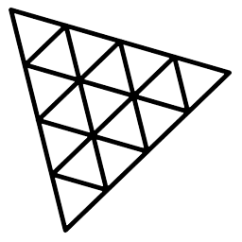
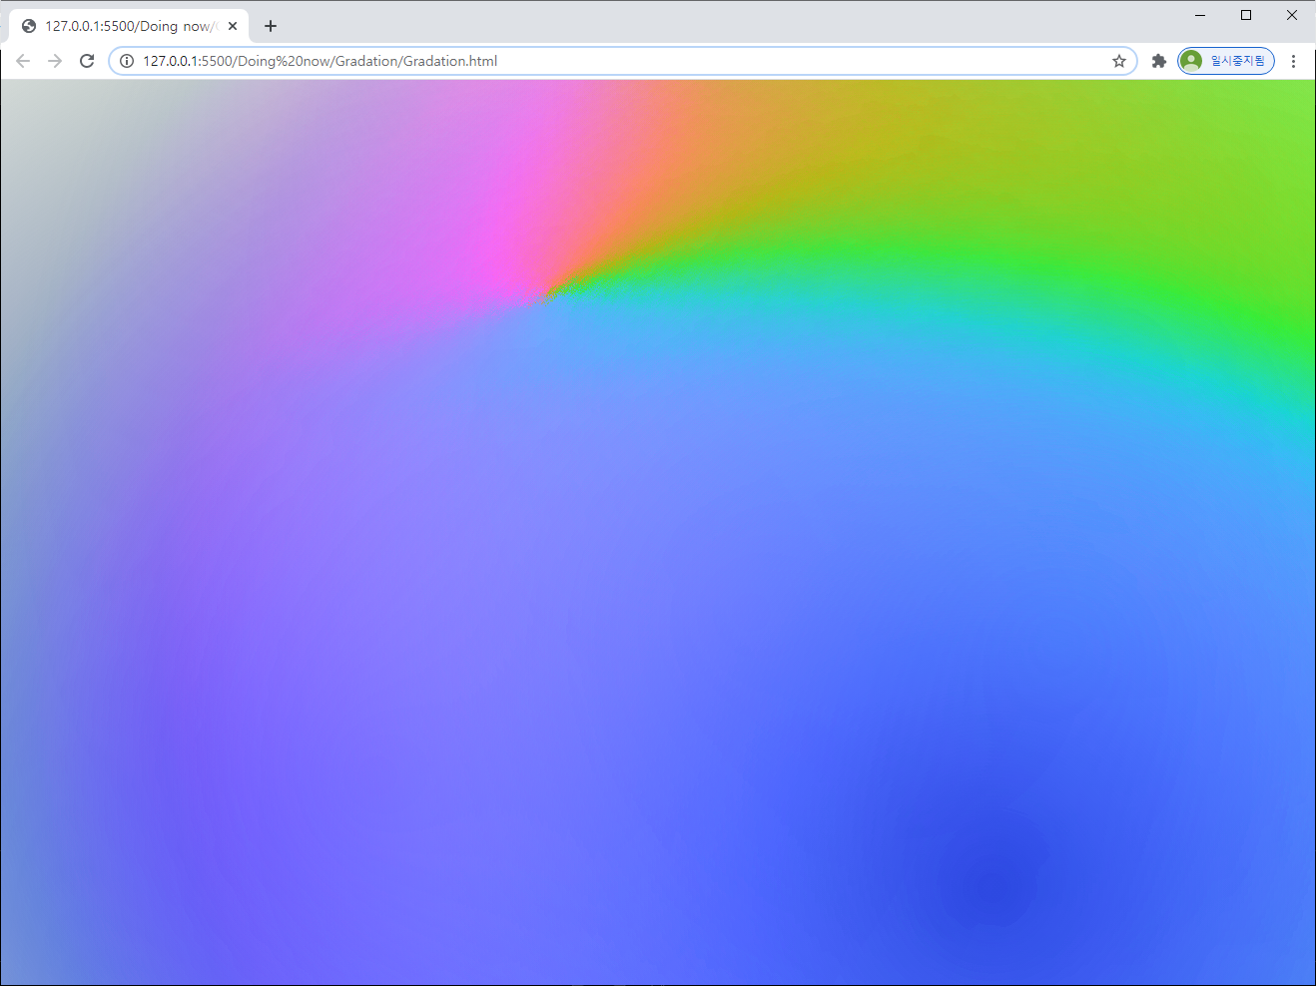

Using Three.js
INTRO

Slide 3
목차
01
THREE.JS ?
02
THREE.JS ON REACT
03
HOW TO USE THREE.JS ON REACT
04
THREE.JS IN MOIN

Slide 4
01-THREE.JS ?
Notes:
Note: Please after inserting your picture, “Right Click” on the picture and “Send it to Back” to get the “Gradient” effect.

Slide 5
Three.js
2010년 4월 Ricardo Cabello
웹페이지에 3D 객체를 쉽게 렌더링하도록 도와주는 자바스크립트 3D 라이브러리
WebGL을 사용하여 렌더링
https://threejs.org/
https://github.com/mrdoob/three.js/

Slide 6

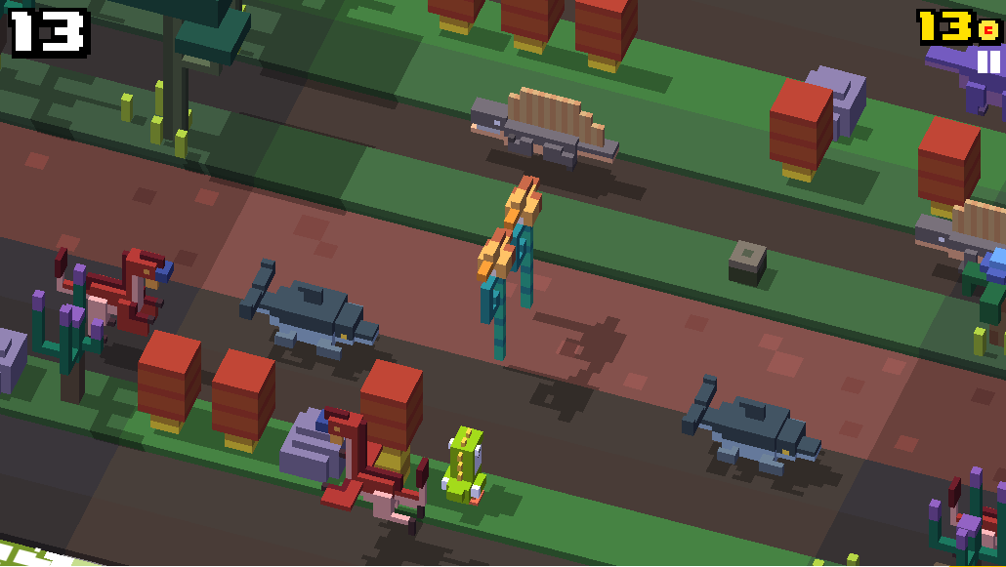
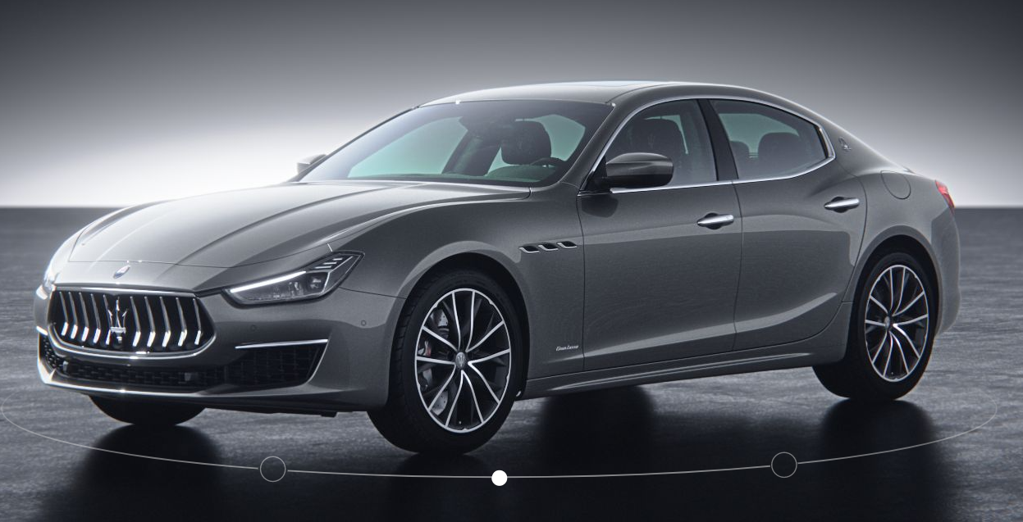
Three.js 예시
ABOUT THREE.JS
Github
Crossy Road
Maserati
Web Design
https://github.com/home
Game
https://poki.com/en/g/crossy-road
Modeling
https://www.maserati.com/kr/ko/Models/ghibli

Slide 7
Three.js 구조
ABOUT THREE.JS
Renderer
Renderer
Scene
Camera
Scene 객체와 Camera 객체를 받아 3D를 렌더링
Scene
Mesh
Object3D
Mesh
Group
Light
최상위 노드, 배경색 및 안개 등의 요소
Camera
Mesh
Mesh
Mesh
Mesh
Camera 시점 역할
Light
Mesh
Object3D
광원을 제공
Mesh
Geometry
Material
Material로 Geometry를 그리는 역할
Geometry
Material
Texture
Geometry
Material
Texture
Material

Slide 8
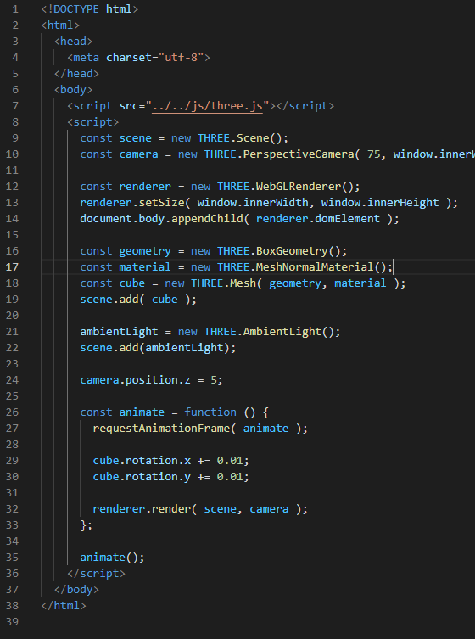
Three.js 구조
ABOUT THREE.JS
Renderer
Scene
Camera
Mesh
Object3D
Mesh
Group
Light
Mesh
Mesh
Mesh
Mesh
Mesh
Object3D
Geometry
Material
Geometry
Material
Texture
Geometry
Material
Texture
Material

Slide 9
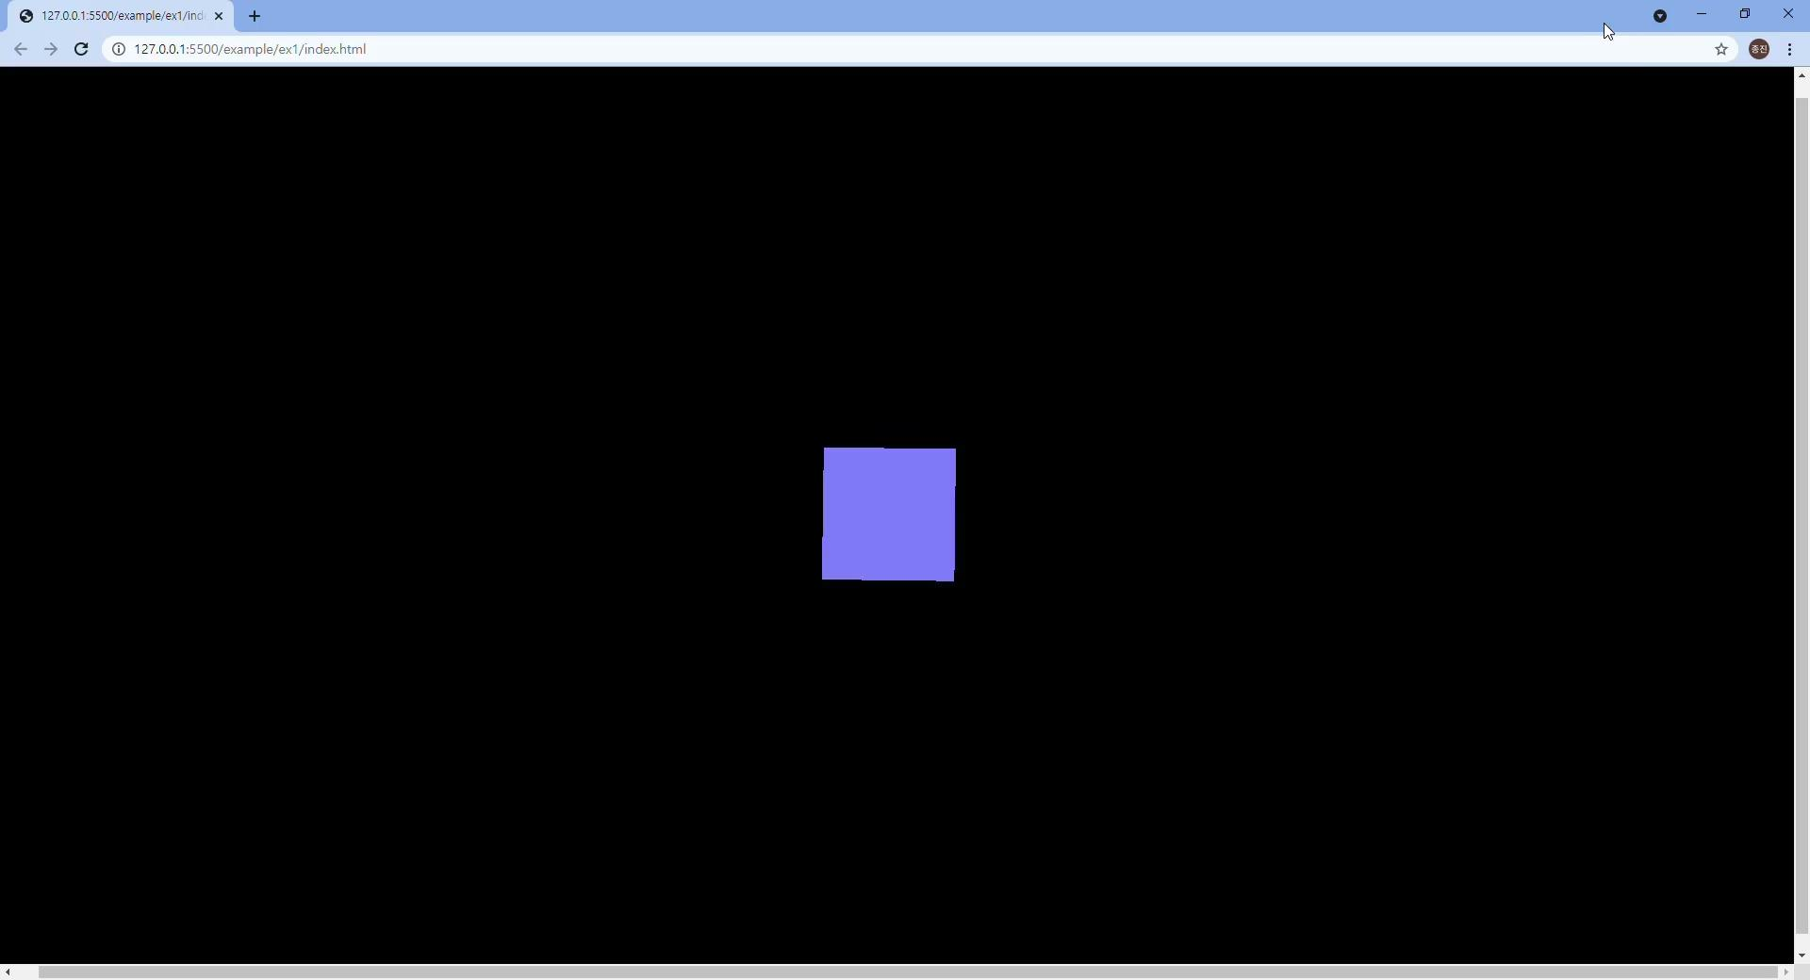
Three.js 구조
ABOUT THREE.JS

Slide 10
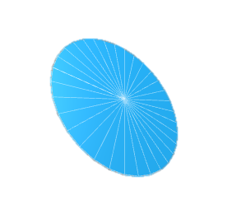
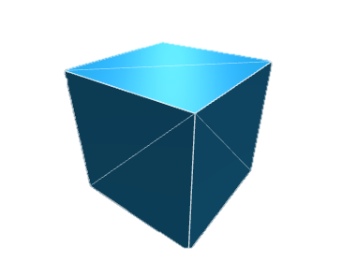
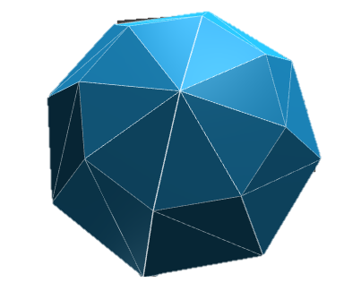

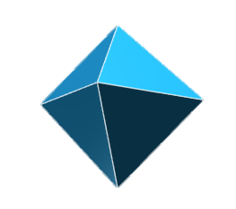
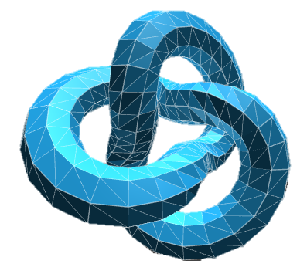
Three.js 구조 - Geometries
ABOUT THREE.JS
2차원
Box
구
PlaneGeometry
CircleGeometry
ShapeGeometry...
BoxGeometry
SphereGeometry
Text
다면체
그 외
TextGeometry
OctahedronGeometry
IcosahedronGeometry
TetrahedronGeometry
TorusKnotGeometry
ExtrudeGeometry
TubeGeometry

Slide 11
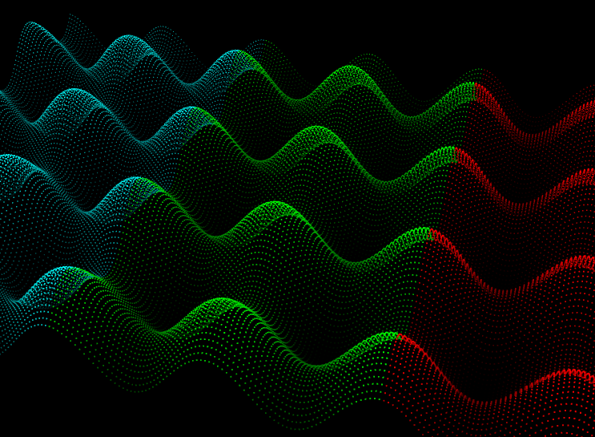
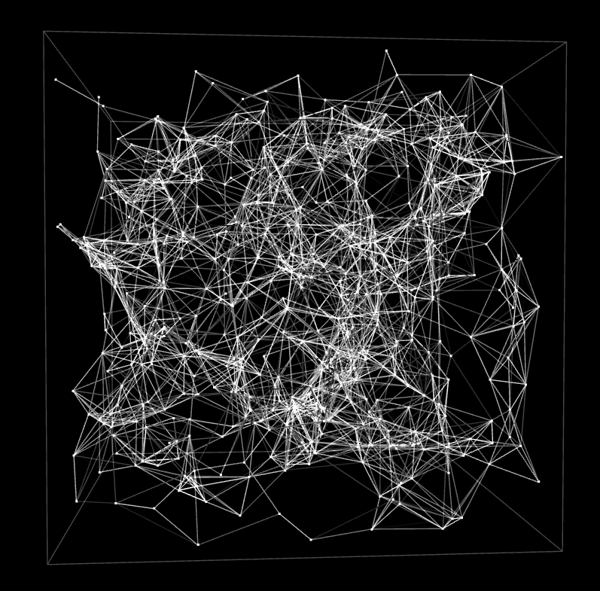

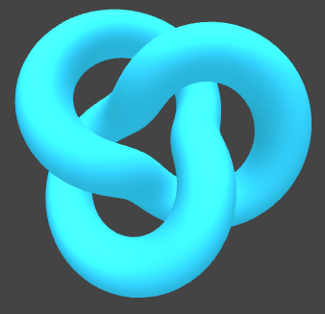
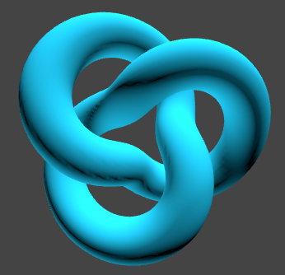
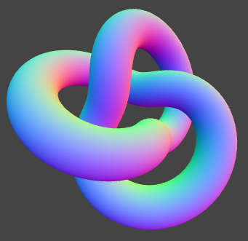
Three.js 구조 - Materials
ABOUT THREE.JS
PointsMaterial
LineBasicMaterial
MeshBasicMaterial
점으로 표현
선으로 표현
wire-frame 스타일을 표현.
가장 단순하게 평면으로 표현
조명 영향 X
MeshStandardMaterial
MeshLambertMaterial
MeshNormalMaterial
물리기반 렌더링의 표준
물리적으로 정확한 모델
반사 하이라이트가 없음
광택이 없어 음영모델에 사용
벡터를 RGB색상값에 mapping

Slide 12
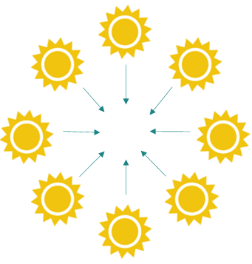
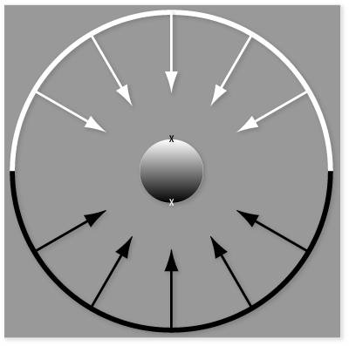
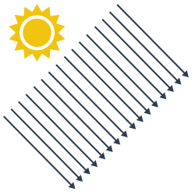
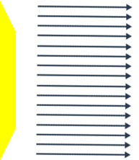


Three.js 구조 - Lights
ABOUT THREE.JS
AmbientLight
HemisphereLight
DirectionalLight
전체적으로 균일하게 비춤
그림자 X
하늘 색과 땅 색을 지정할 수 있음
그림자 X
태양빛처럼 위에서 아래로 비춤
RectAreaLight
PointLight
SpotLight
직사각형 평면에서 방출되는 빛
창문 등에 사용
한 지점에서 방출되는 빛
전구와 비슷
빛이 원뿔 형태로 나아감
스포트라이트 조명

Slide 13
02-THREE.JS ON REACT
Notes:
Note: Please after inserting your picture, “Right Click” on the picture and “Send it to Back” to get the “Gradient” effect.

Slide 14

React Three Fiber
React 및 React native에서 3D 객체를 쉽게 렌더링하도록 도와주는 Three.js의 Renderer
Three.js의 모든 기능을 제공
https://www.npmjs.com/package/react-three-fiber
https://github.com/pmndrs/react-three-fiber

Slide 15
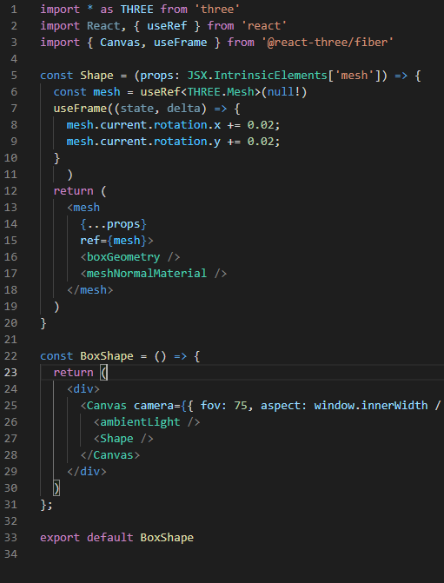
Three.js VS React Three Fiber
ABOUT REACT THREE FIBER
Canvas
Mesh
useFrame
Light
Three.js
React Three Fiber

Slide 16
Three.js VS React Three Fiber
ABOUT REACT THREE FIBER
Canvas
Mesh
useFrame
Light
Three.js
React Three Fiber

Slide 17
Three.js VS React Three Fiber
ABOUT REACT THREE FIBER
Canvas
Mesh
useFrame
Light
Three.js
React Three Fiber

Slide 18
Three.js VS React Three Fiber
ABOUT REACT THREE FIBER
Canvas
Mesh
useFrame
Light
Three.js
React Three Fiber

Slide 19
Three.js VS React Three Fiber
ABOUT REACT THREE FIBER
Canvas
Mesh
useFrame
Light
Three.js
React Three Fiber

Slide 20
React Three Drei
React Three Fiber에 추가하여 다양한 기능 제공
더 쉽고 빠르게 기능 사용 가능
https://www.npmjs.com/package/@react-three/drei
https://github.com/pmndrs/drei

Slide 21
03-HOW TO USE
THREE.JS ON REACT
Notes:
Note: Please after inserting your picture, “Right Click” on the picture and “Send it to Back” to get the “Gradient” effect.

Slide 22
Using Three.js on React
HOW TO USE
Create React App
npx create-react-app my-app --template typescript
Install
npm install three
npm install three @react-three/fiber
npm install @react-three/drei

Slide 23
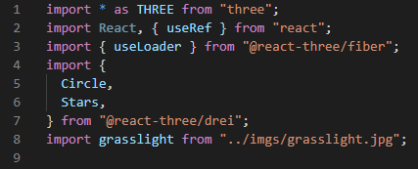
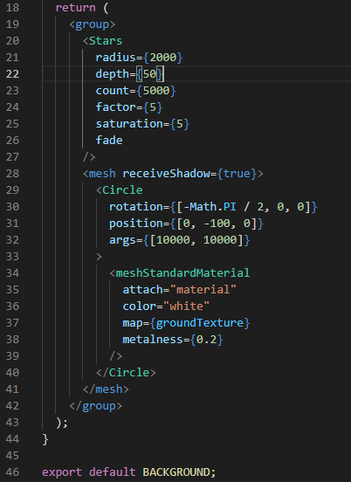
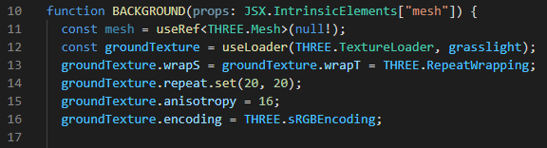
Using Three.js on React
HOW TO USE
Load Image
import { useLoader } from ‘@react-three/fiber’

Slide 24
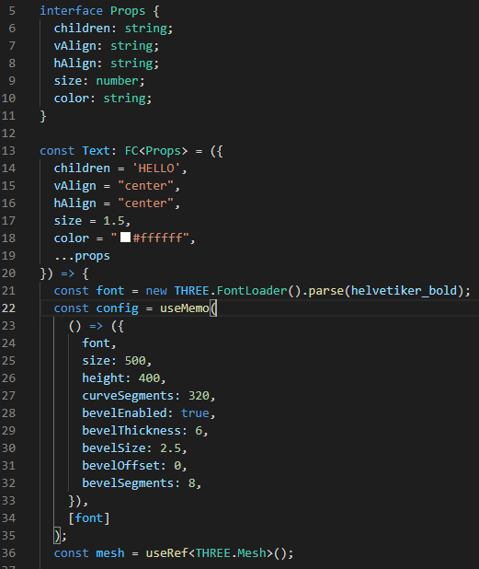
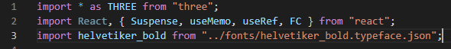
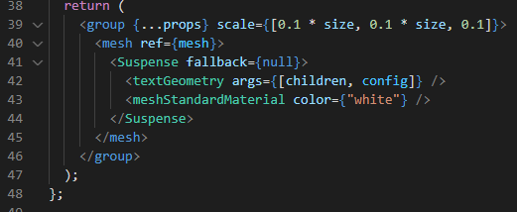
Using Three.js on React
HOW TO USE
Load Font

Slide 25
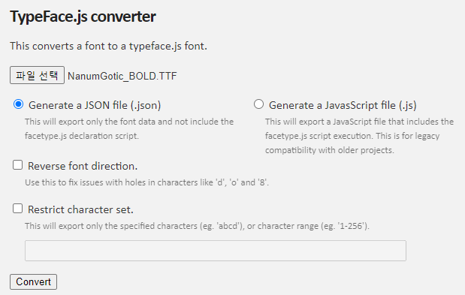
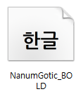
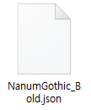
Using Three.js on React
HOW TO USE
Load Font
http://gero3.github.io/facetype.js/
Download Font
TypeFace converter
JSON

Slide 26




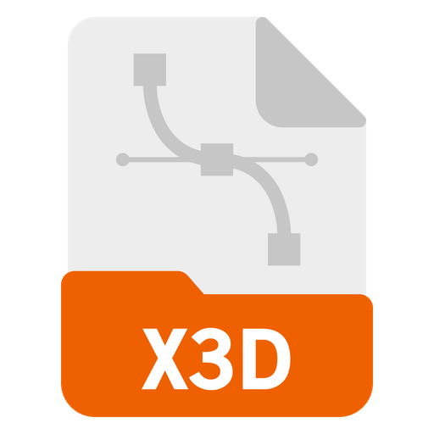


Using Three.js on React
HOW TO USE
3D File Format List
3D Loader
blender
gltf / glb
- 3DMLoader
- DRACOLoader
- GLTFLoader
- MMDLoader
- MTLLoader
- OBJLoader
- PCDLoader
- PDBLoader
- PRWMLoader
obj
stl
x3d
ply
dae
...

Slide 27
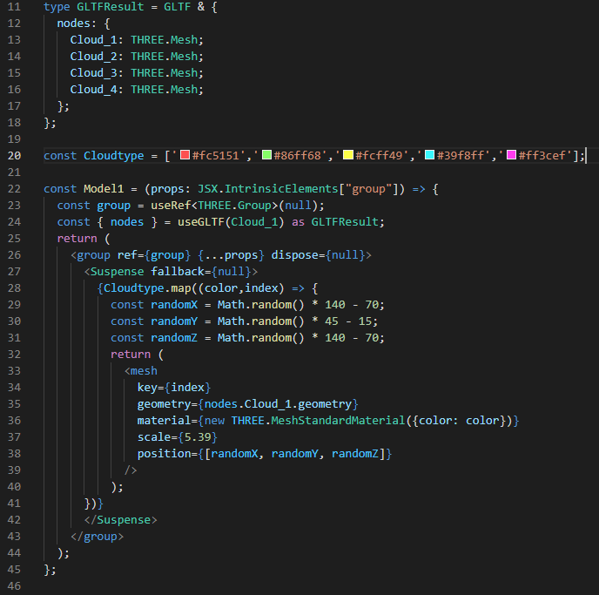
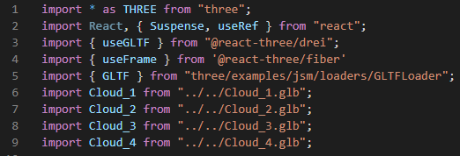
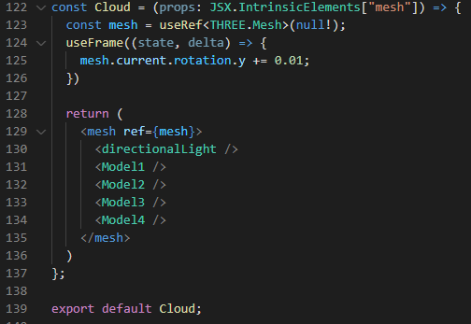
Using Three.js on React
HOW TO USE
Load 3D file

Slide 28
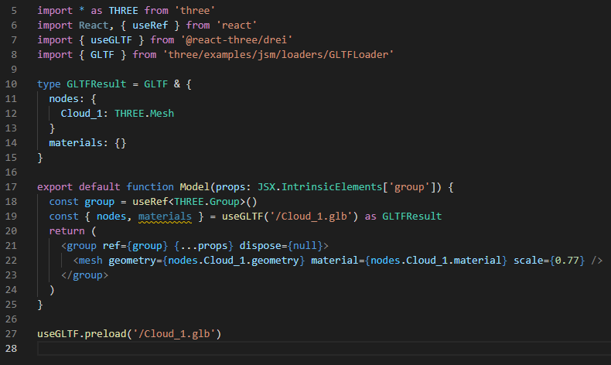
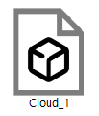
Using Three.js on React
HOW TO USE
Load 3D file
npx gltfjsx model.gltf --types
https://github.com/pmndrs/gltfjsx
Download glb file
npx gltfjsx Cloud_1.glb --types

Slide 29
04-THREE.JS IN MOIN
Notes:
Note: Please after inserting your picture, “Right Click” on the picture and “Send it to Back” to get the “Gradient” effect.

Slide 30
Using Three.js in MOIN
ABOUT MOIN
https://www.themoin.com/

Slide 31

Using Three.js in MOIN
ABOUT MOIN
Zenly
지구본을 이용하여
송금 가능 국가 보여주기
https://zen.ly/

Slide 32
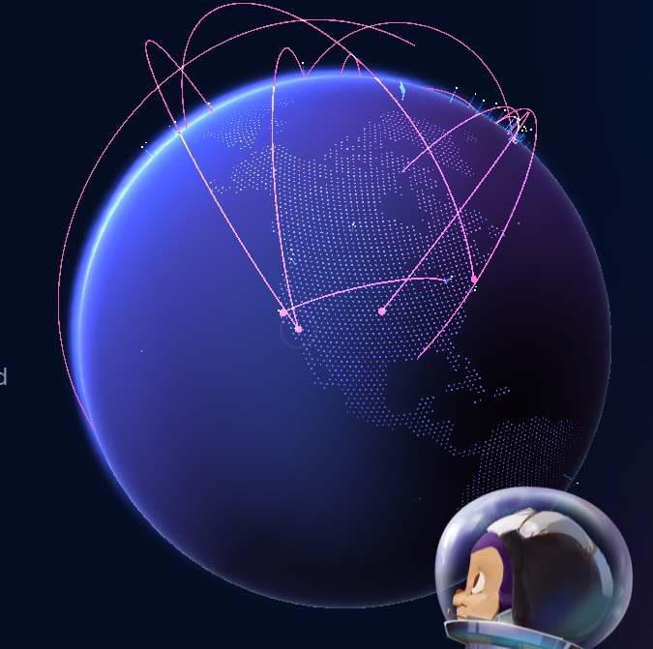
Using Three.js in MOIN
ABOUT MOIN
Github
한국에서
송금 가능한 국가로
선을 표시
https://github.com/home

Slide 33
Thank you!

